Slide 1
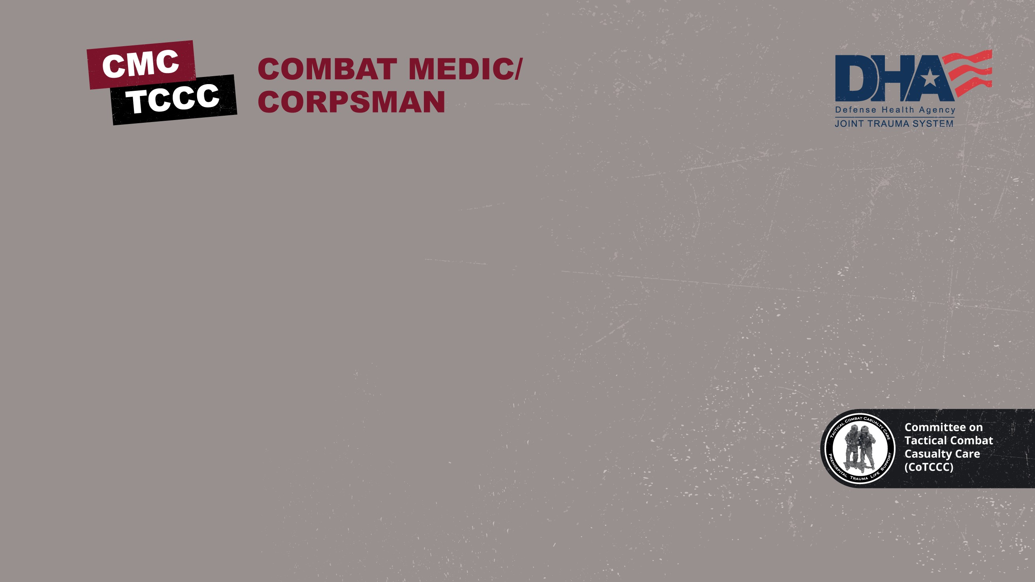


TACTICAL COMBAT CASUALTY CARE COURSE
Module 13: Head Injuries
MODULE 13: HEAD INJURIES
TCCC TIER 1
All Service Members
TCCC TIER 2
Combat Lifesaver
TCCC TIER 3
Combat Medic/Corpsman
TCCC TIER 4
Combat Paramedic/Provider

Slide 2

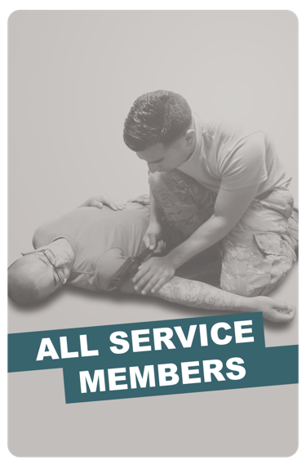
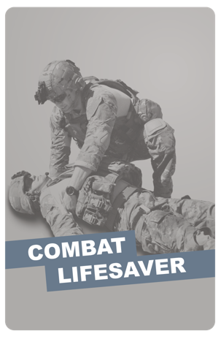
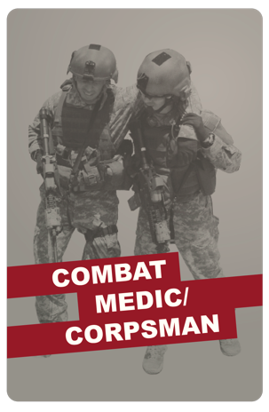
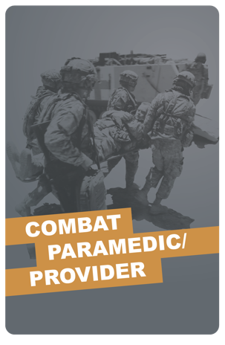
Module 13: Head Injuries
TACTICAL COMBAT CASUALTY CARE (TCCC) ROLE-BASED TRAINING SPECTRUM
ROLE 1 CARE
NONMEDICAL PERSONNEL
MEDICAL PERSONNEL
YOU ARE HERE
STANDARDIZED JOINT CURRICULUM

Slide 3




Module 13: Head Injuries
1 x TERMINAL LEARNING OBJECTIVE
Identify a head injury iaw TCCC Guidelines.
  Identify external forces that can cause a head injury.
  Identify signs and symptoms of a head injury
  Identify the indications for performing a Military Acute Concussion Evaluation 2 (MACE 2) for a casualty with a suspected head injury.
  Identify the progressive strategies and constraints for management of a suspected head injury in Tactical Field Care.
  Identify the signs an symptoms of impending cerebral herniation in Tactical Field Care.
05 x ENABLING LEARNING OBJECTIVES
= Cognitive ELOs

Slide 4



Three PHASES of TCCC
Module 13: Head Injuries
1
CARE UNDER FIRE (CUF)
/ THREAT
2
TACTICAL FIELD CARE (TFC)
WORK UNDER COVER AND CONCEALMENT
3
TACTICAL EVACUATION CARE (TACEVAC)
RETURN FIRE AND TAKE COVER
MORE DELIBERATE ASSESSMENT AND PRE- EVACUATION PROCEDURES
YOU ARE HERE

Slide 5
MARCH PAWS
LIFE-THREATENING
AFTER LIFE-THREATENING
P A W S
_{M} MASSIVE BLEEDING
#1 Priority
_{A} AIRWAY
_{R} RESPIRATION (Breathing)
_{C} CIRCULATION
PAIN
ANTIBIOTICS
WOUNDS
SPLINTING
H
HYPOTHERMIA / HEAD INJURIES

Slide 6
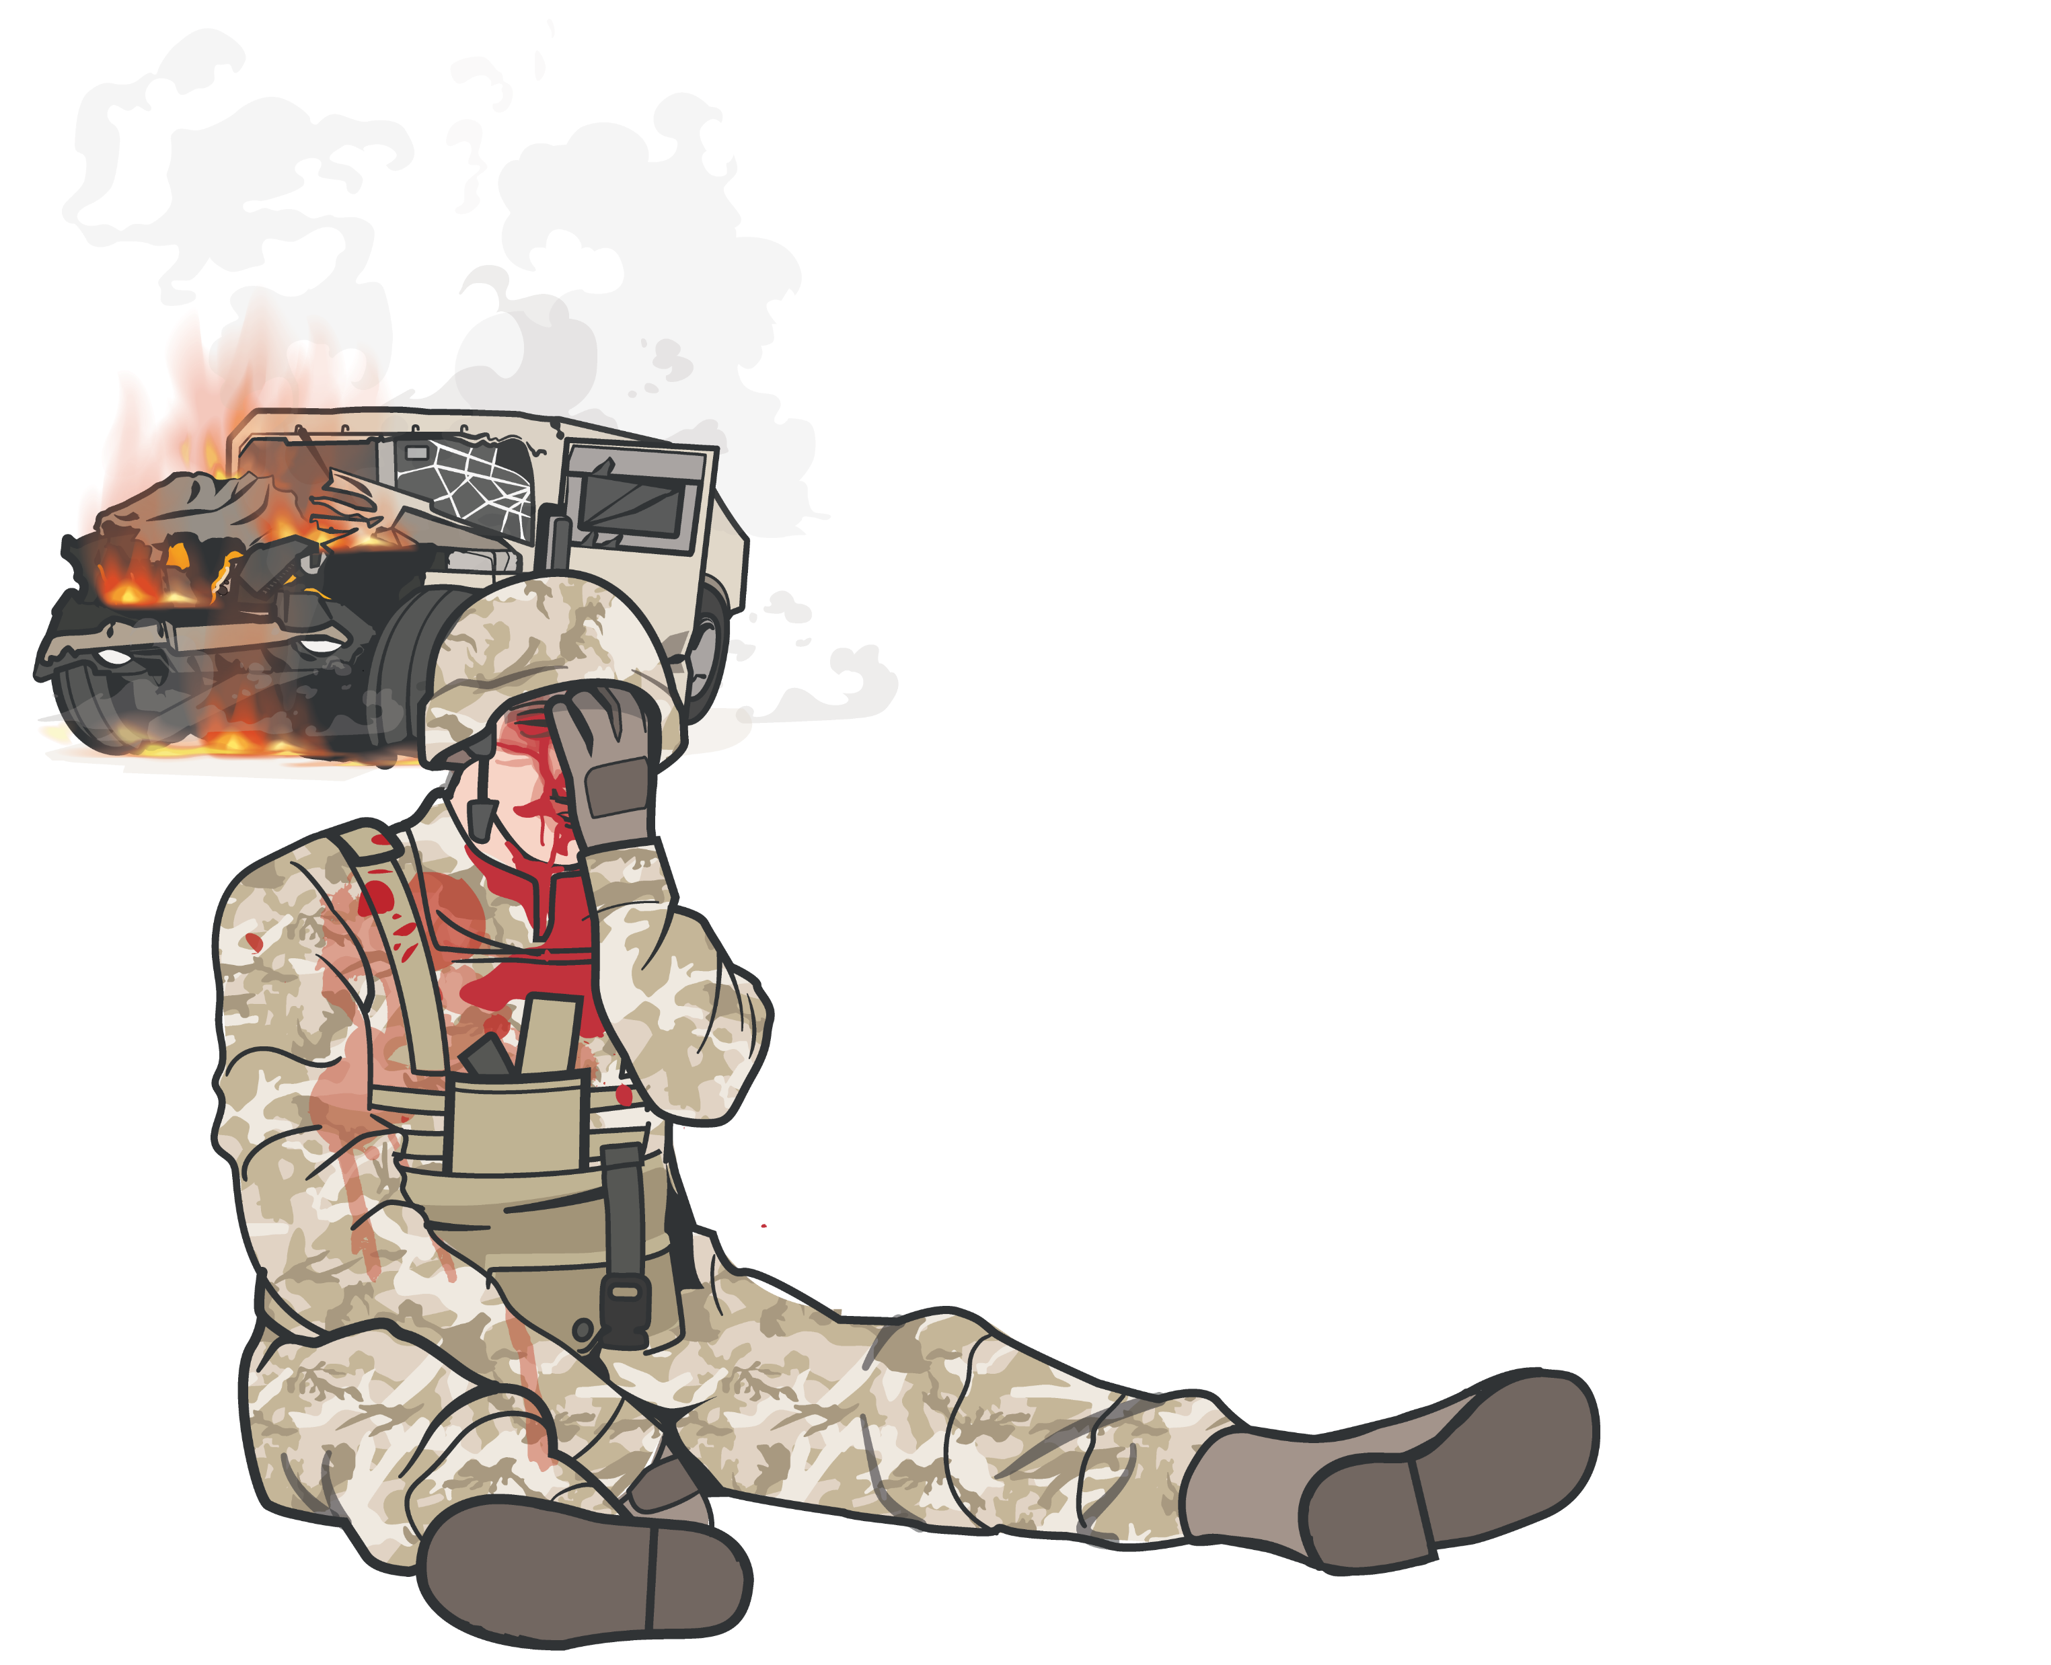
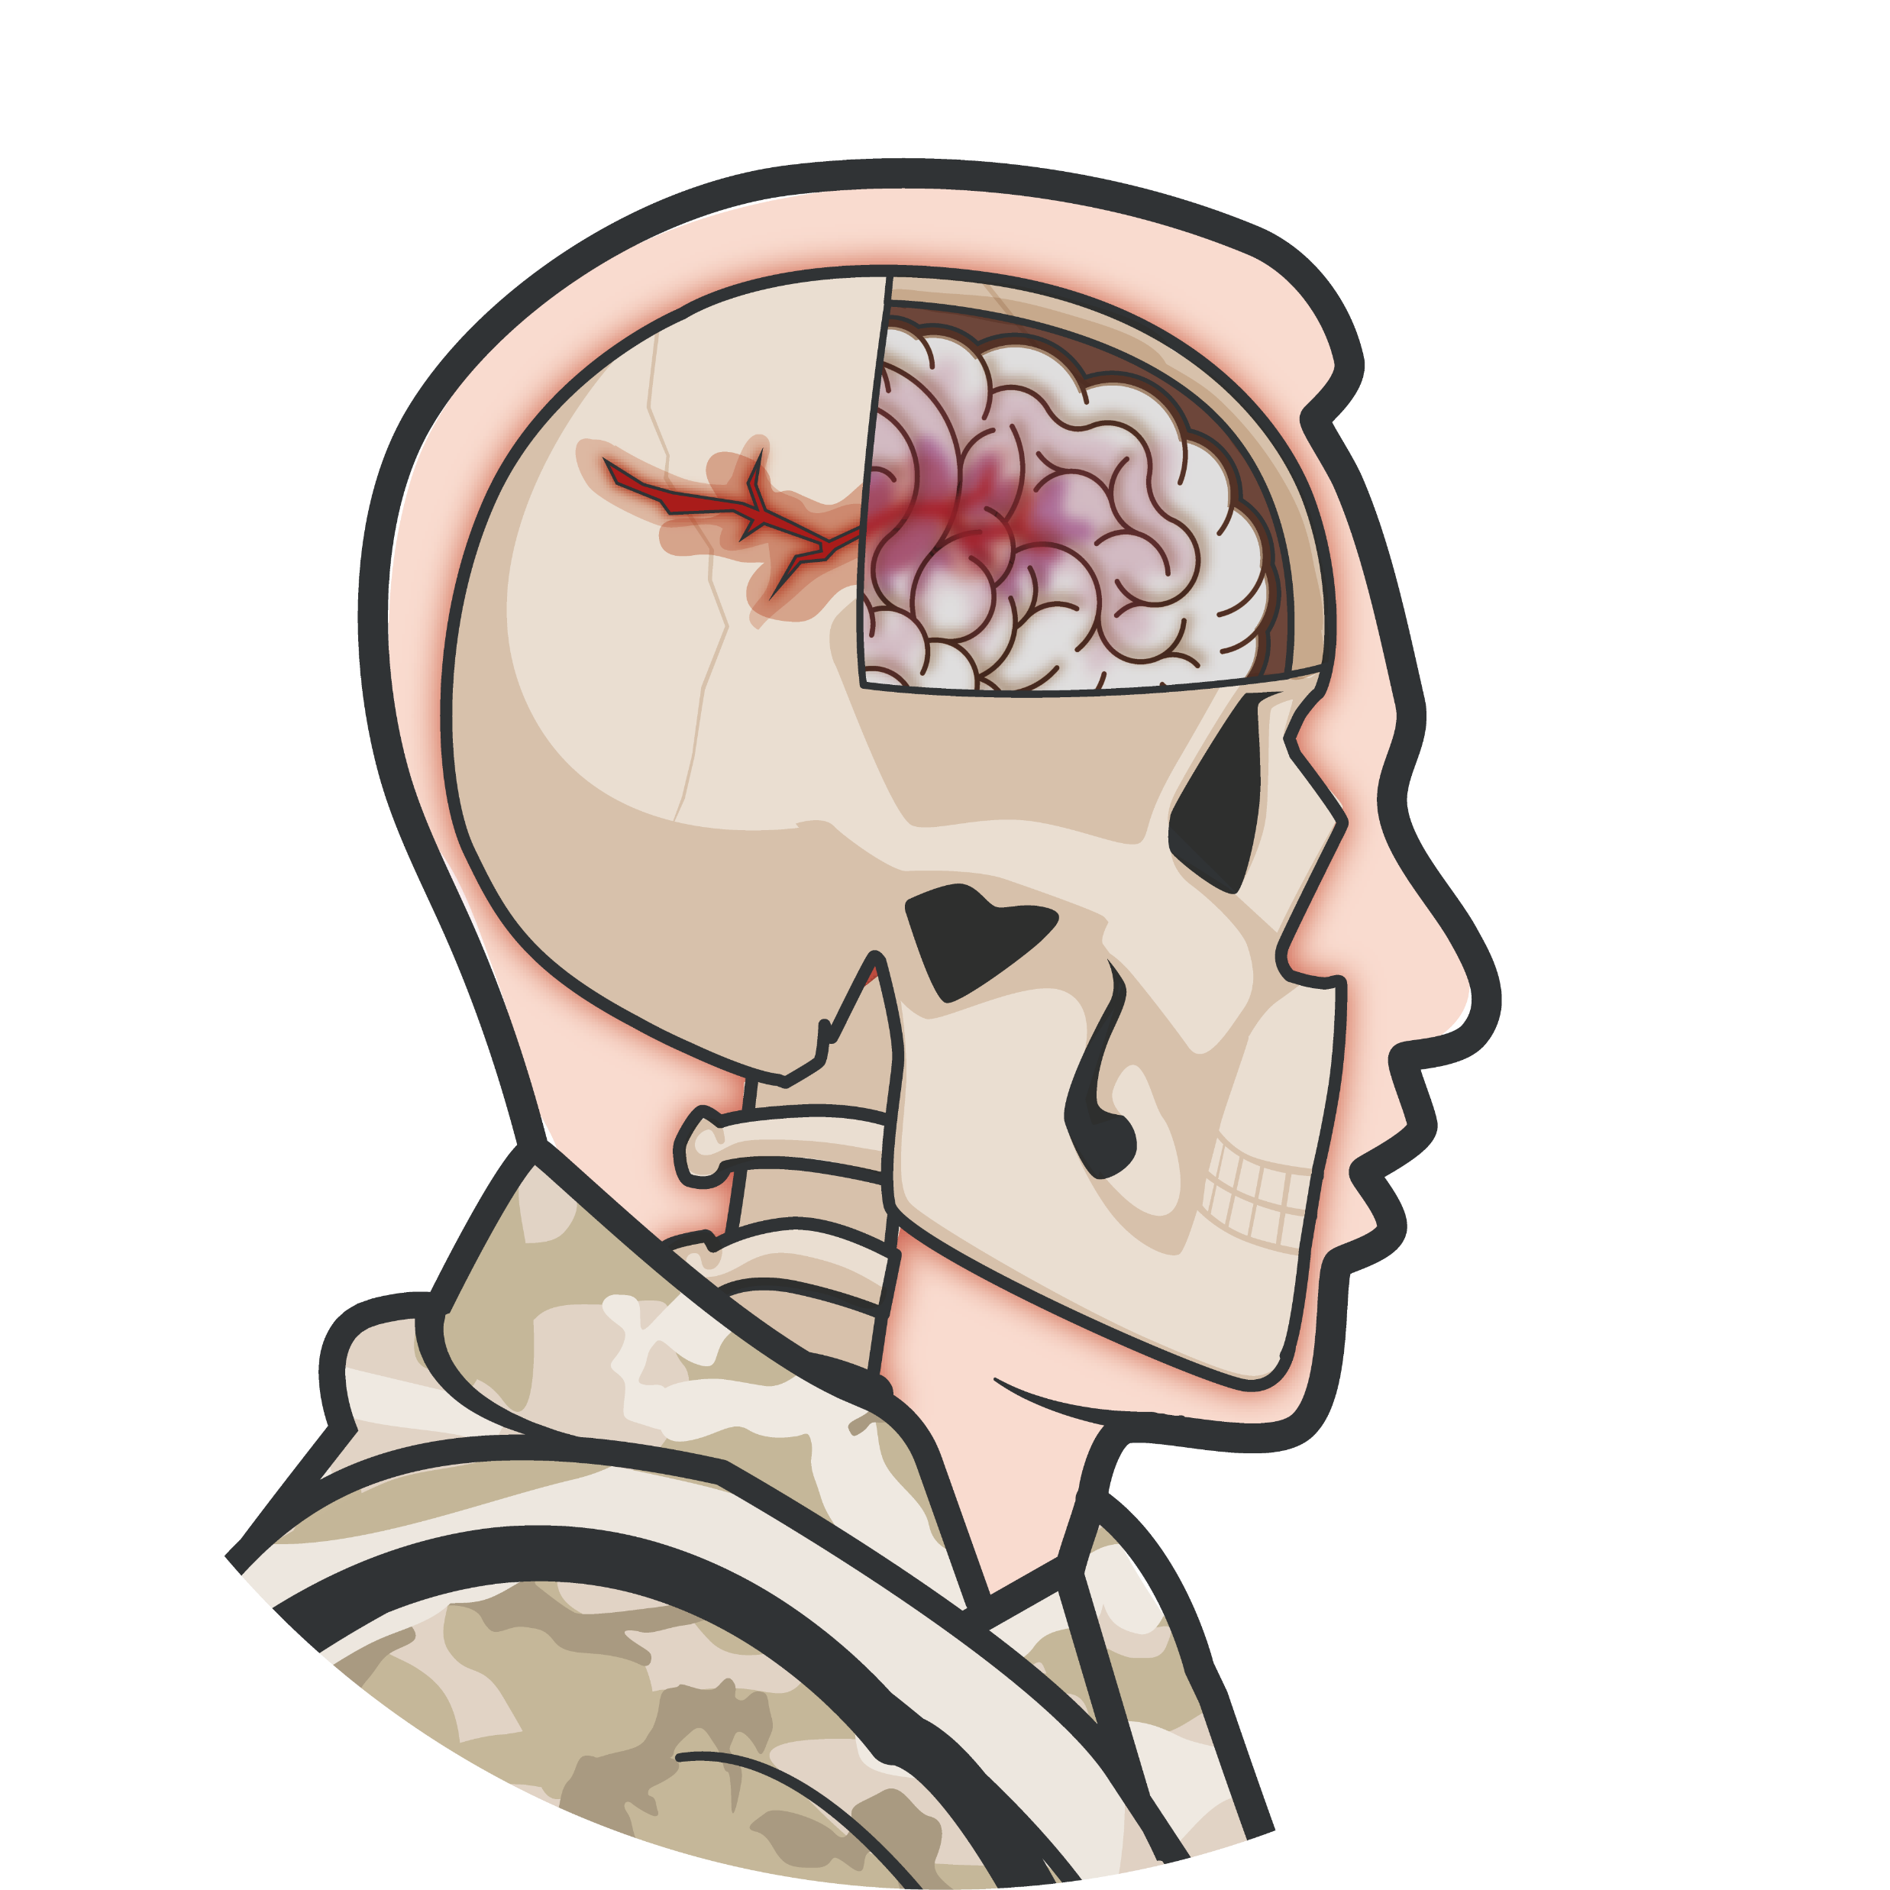
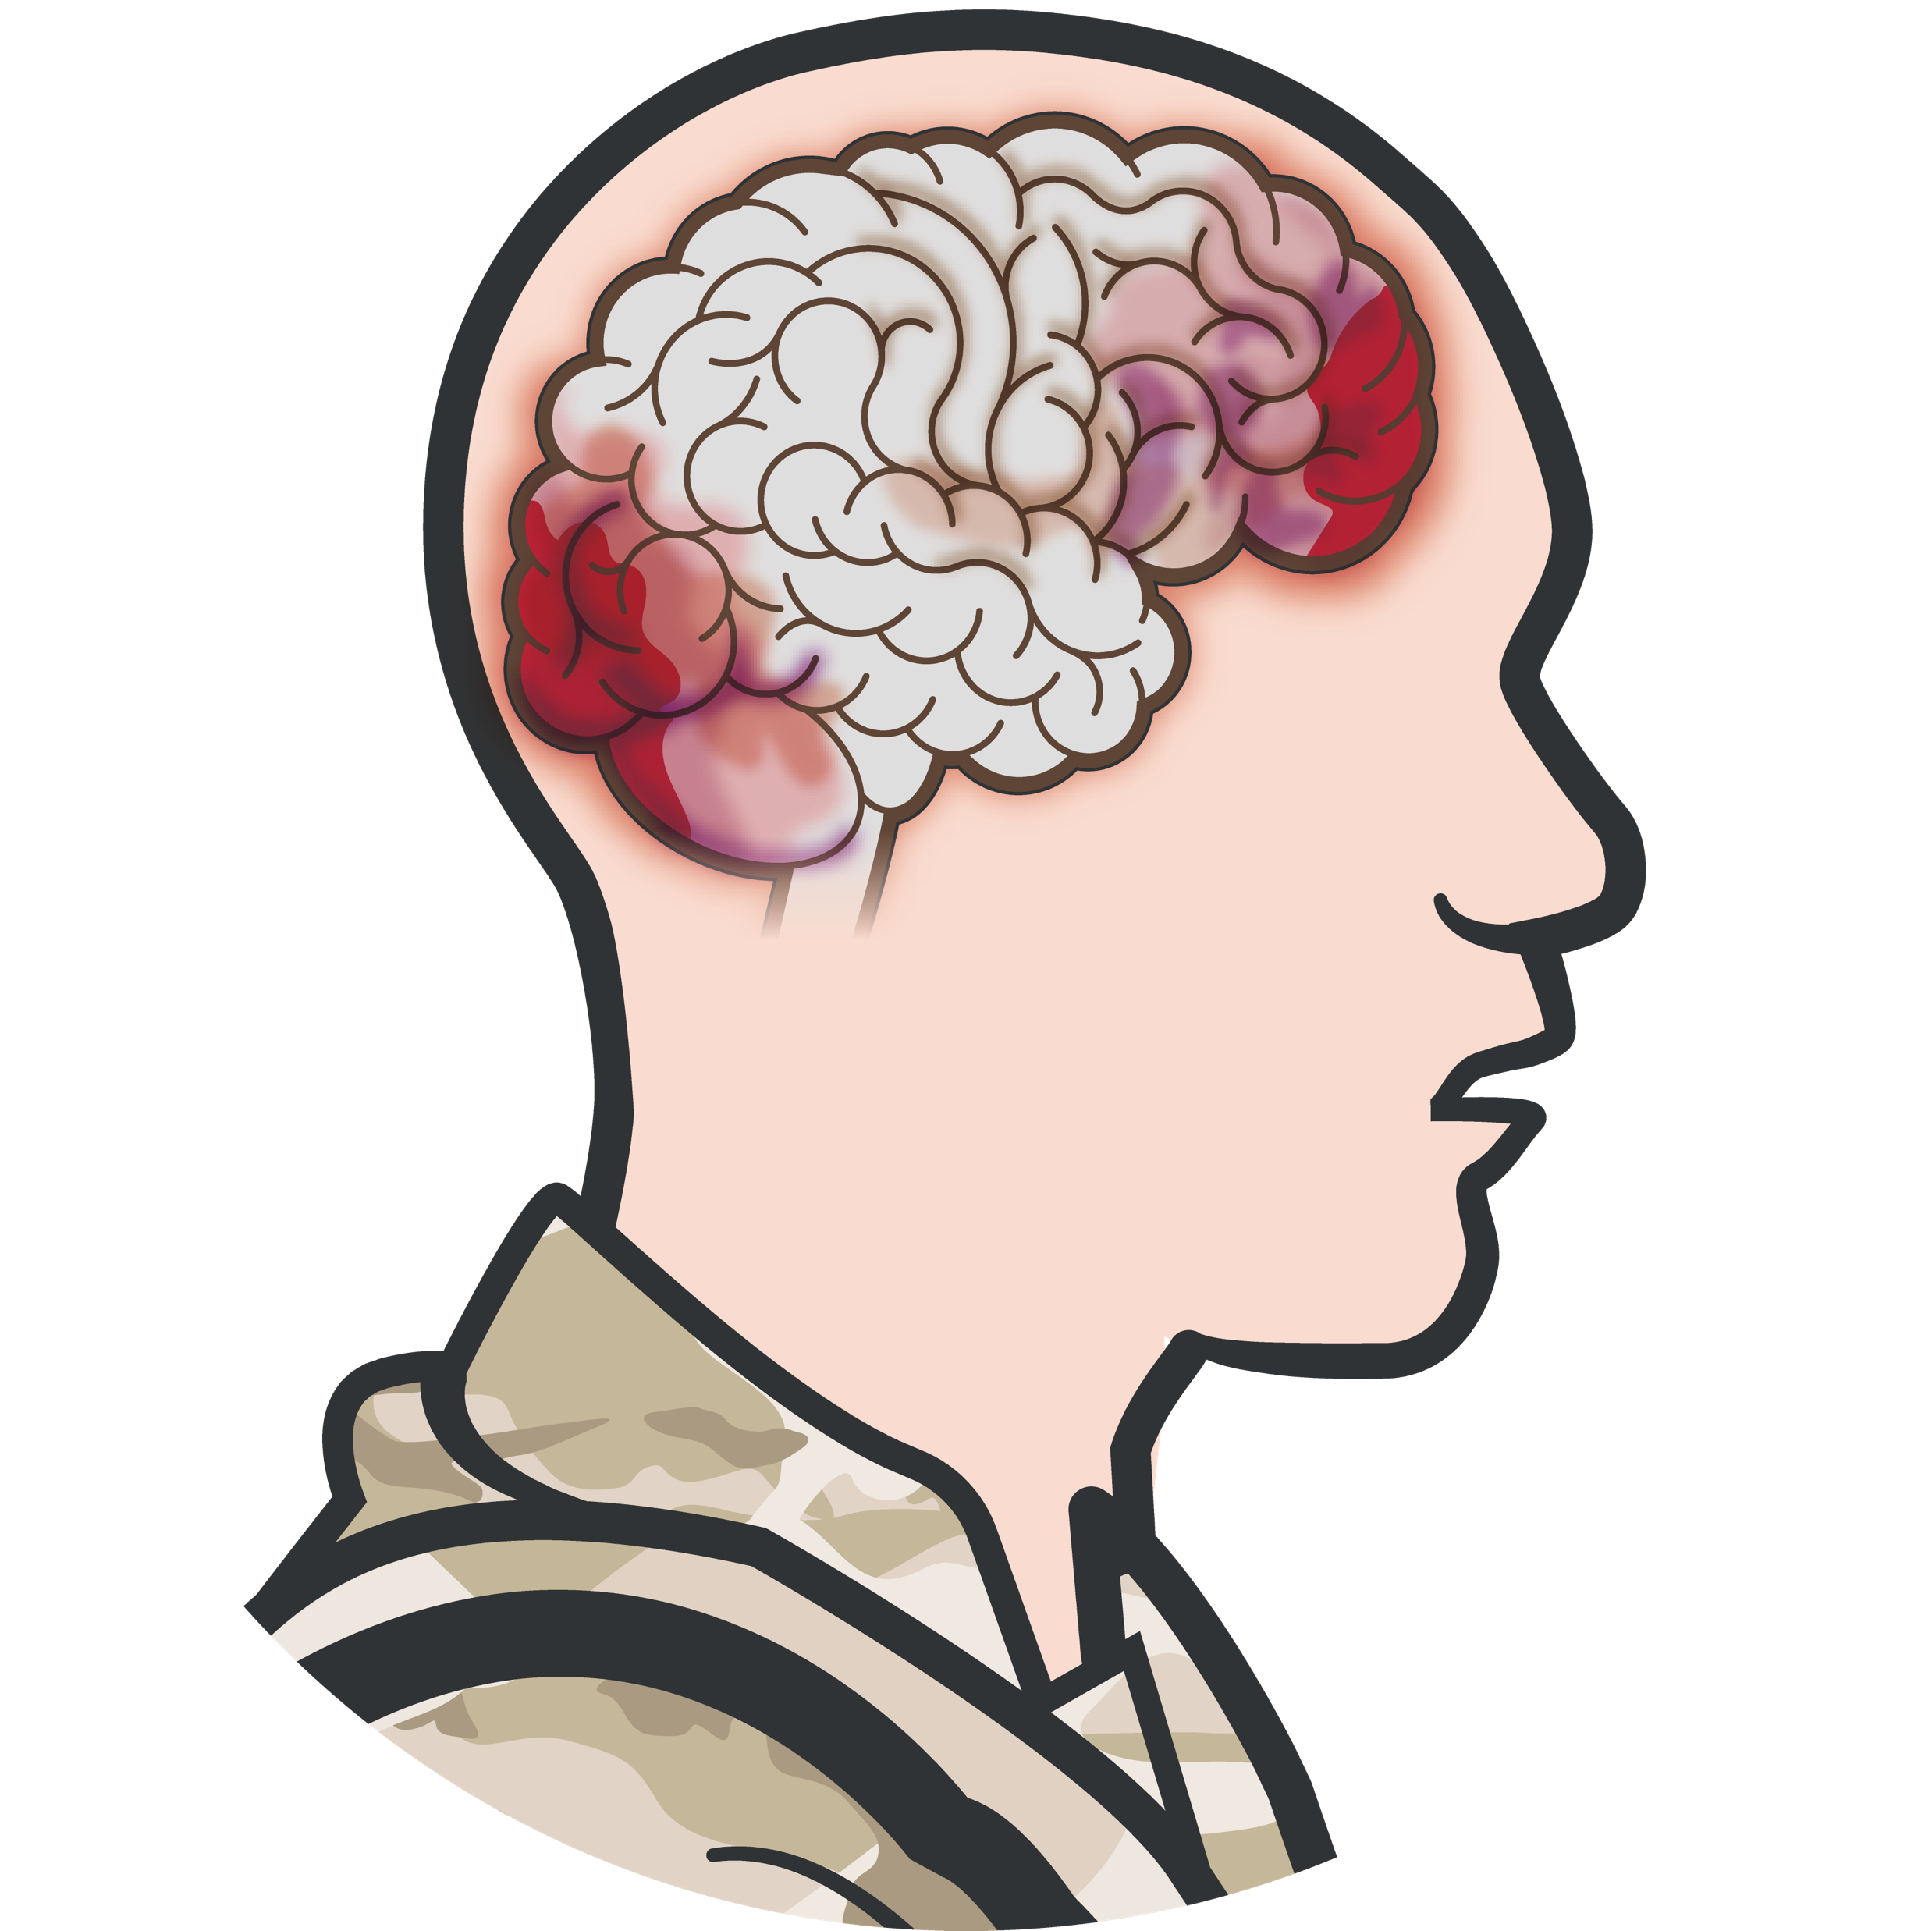
TYPES OF HEAD INJURY
HEAD INJURY IS TRAUMA TO THE SCALP, SKULL, OR BRAIN
Module 13: Head Injuries
Blunt TBI/closed head injury (blast event, fall, vehicle collision/ rollover, etc.)
Penetrating TBI/open head injury (gunshot or shrapnel wound, open skull fracture, etc.)
Open head injuries may be obvious while closed head injuries may not

Slide 7
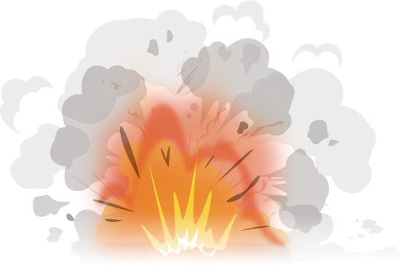
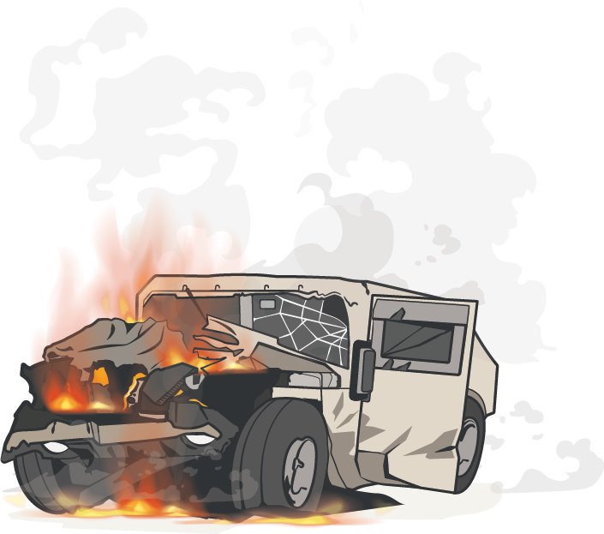
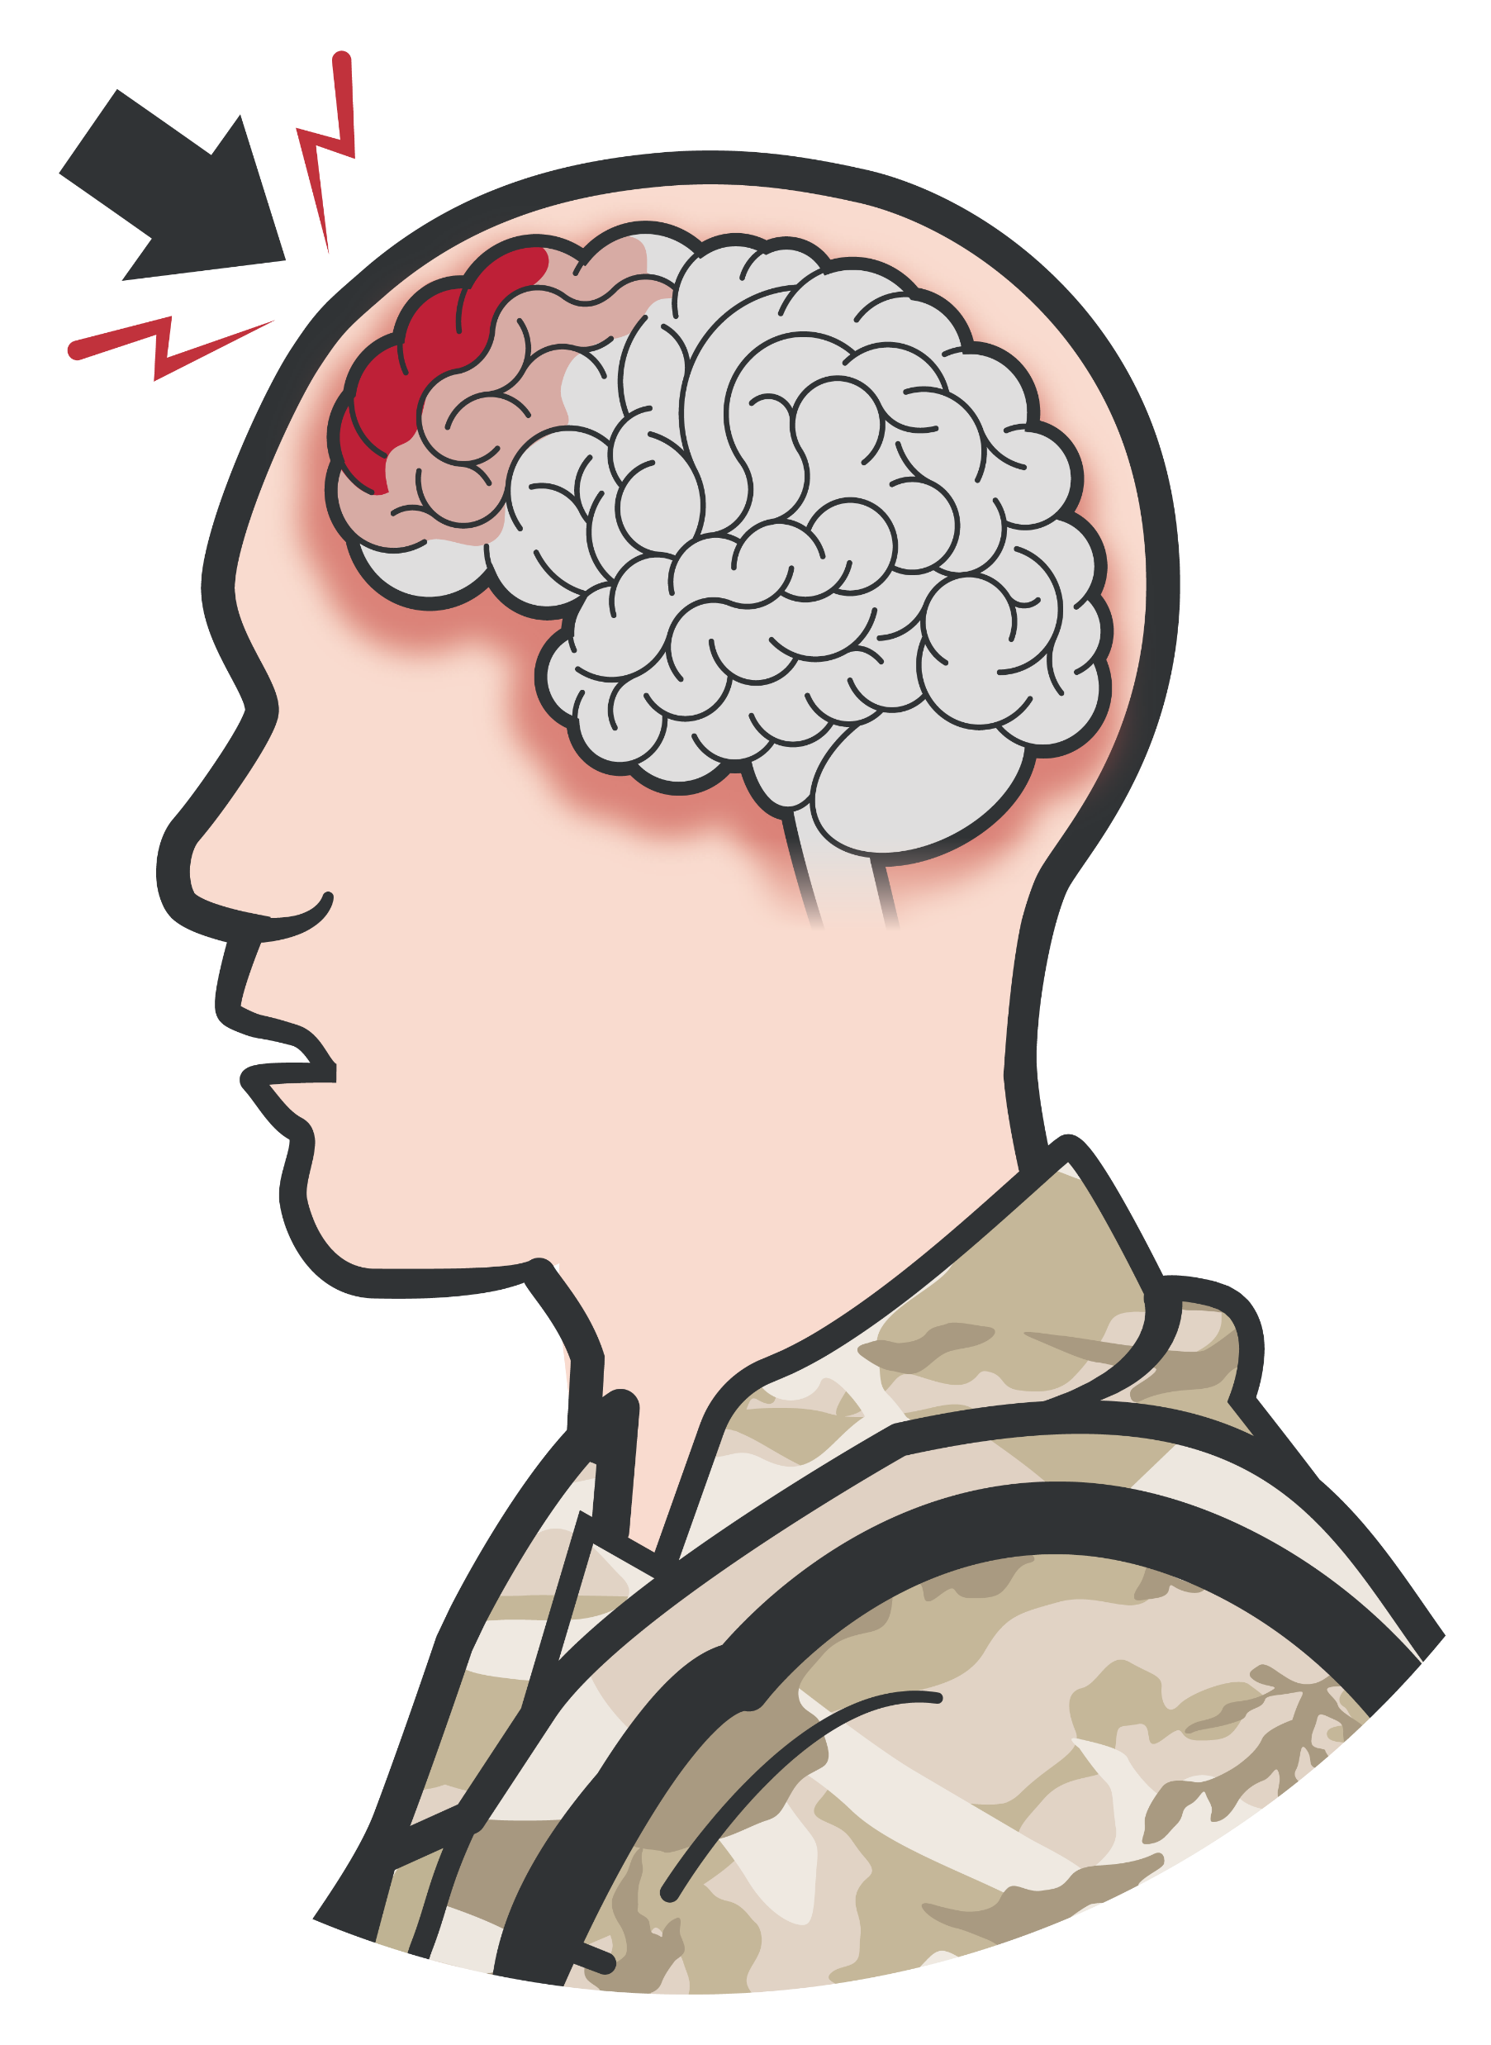
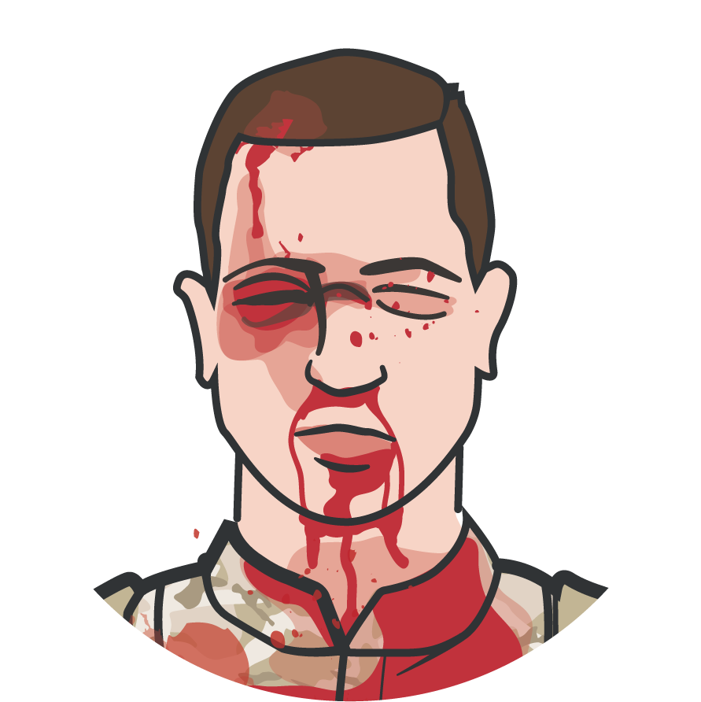
POTENTIAL MECHANISMS OF HEAD INJURY
Module 13: Head Injuries
Involvement in a vehicle blast event, collision, or rollover
Presence within 50 METERS of any blast (inside or outside)
A direct blow to the head or witnessed loss of consciousness
Exposure to more than one blast event
Gunshot or shrapnel wound to head, open skull fracture, etc.
Blasts
MVAs
Direct Blow to the Head
Gunshot/ Shrapnel

Slide 8
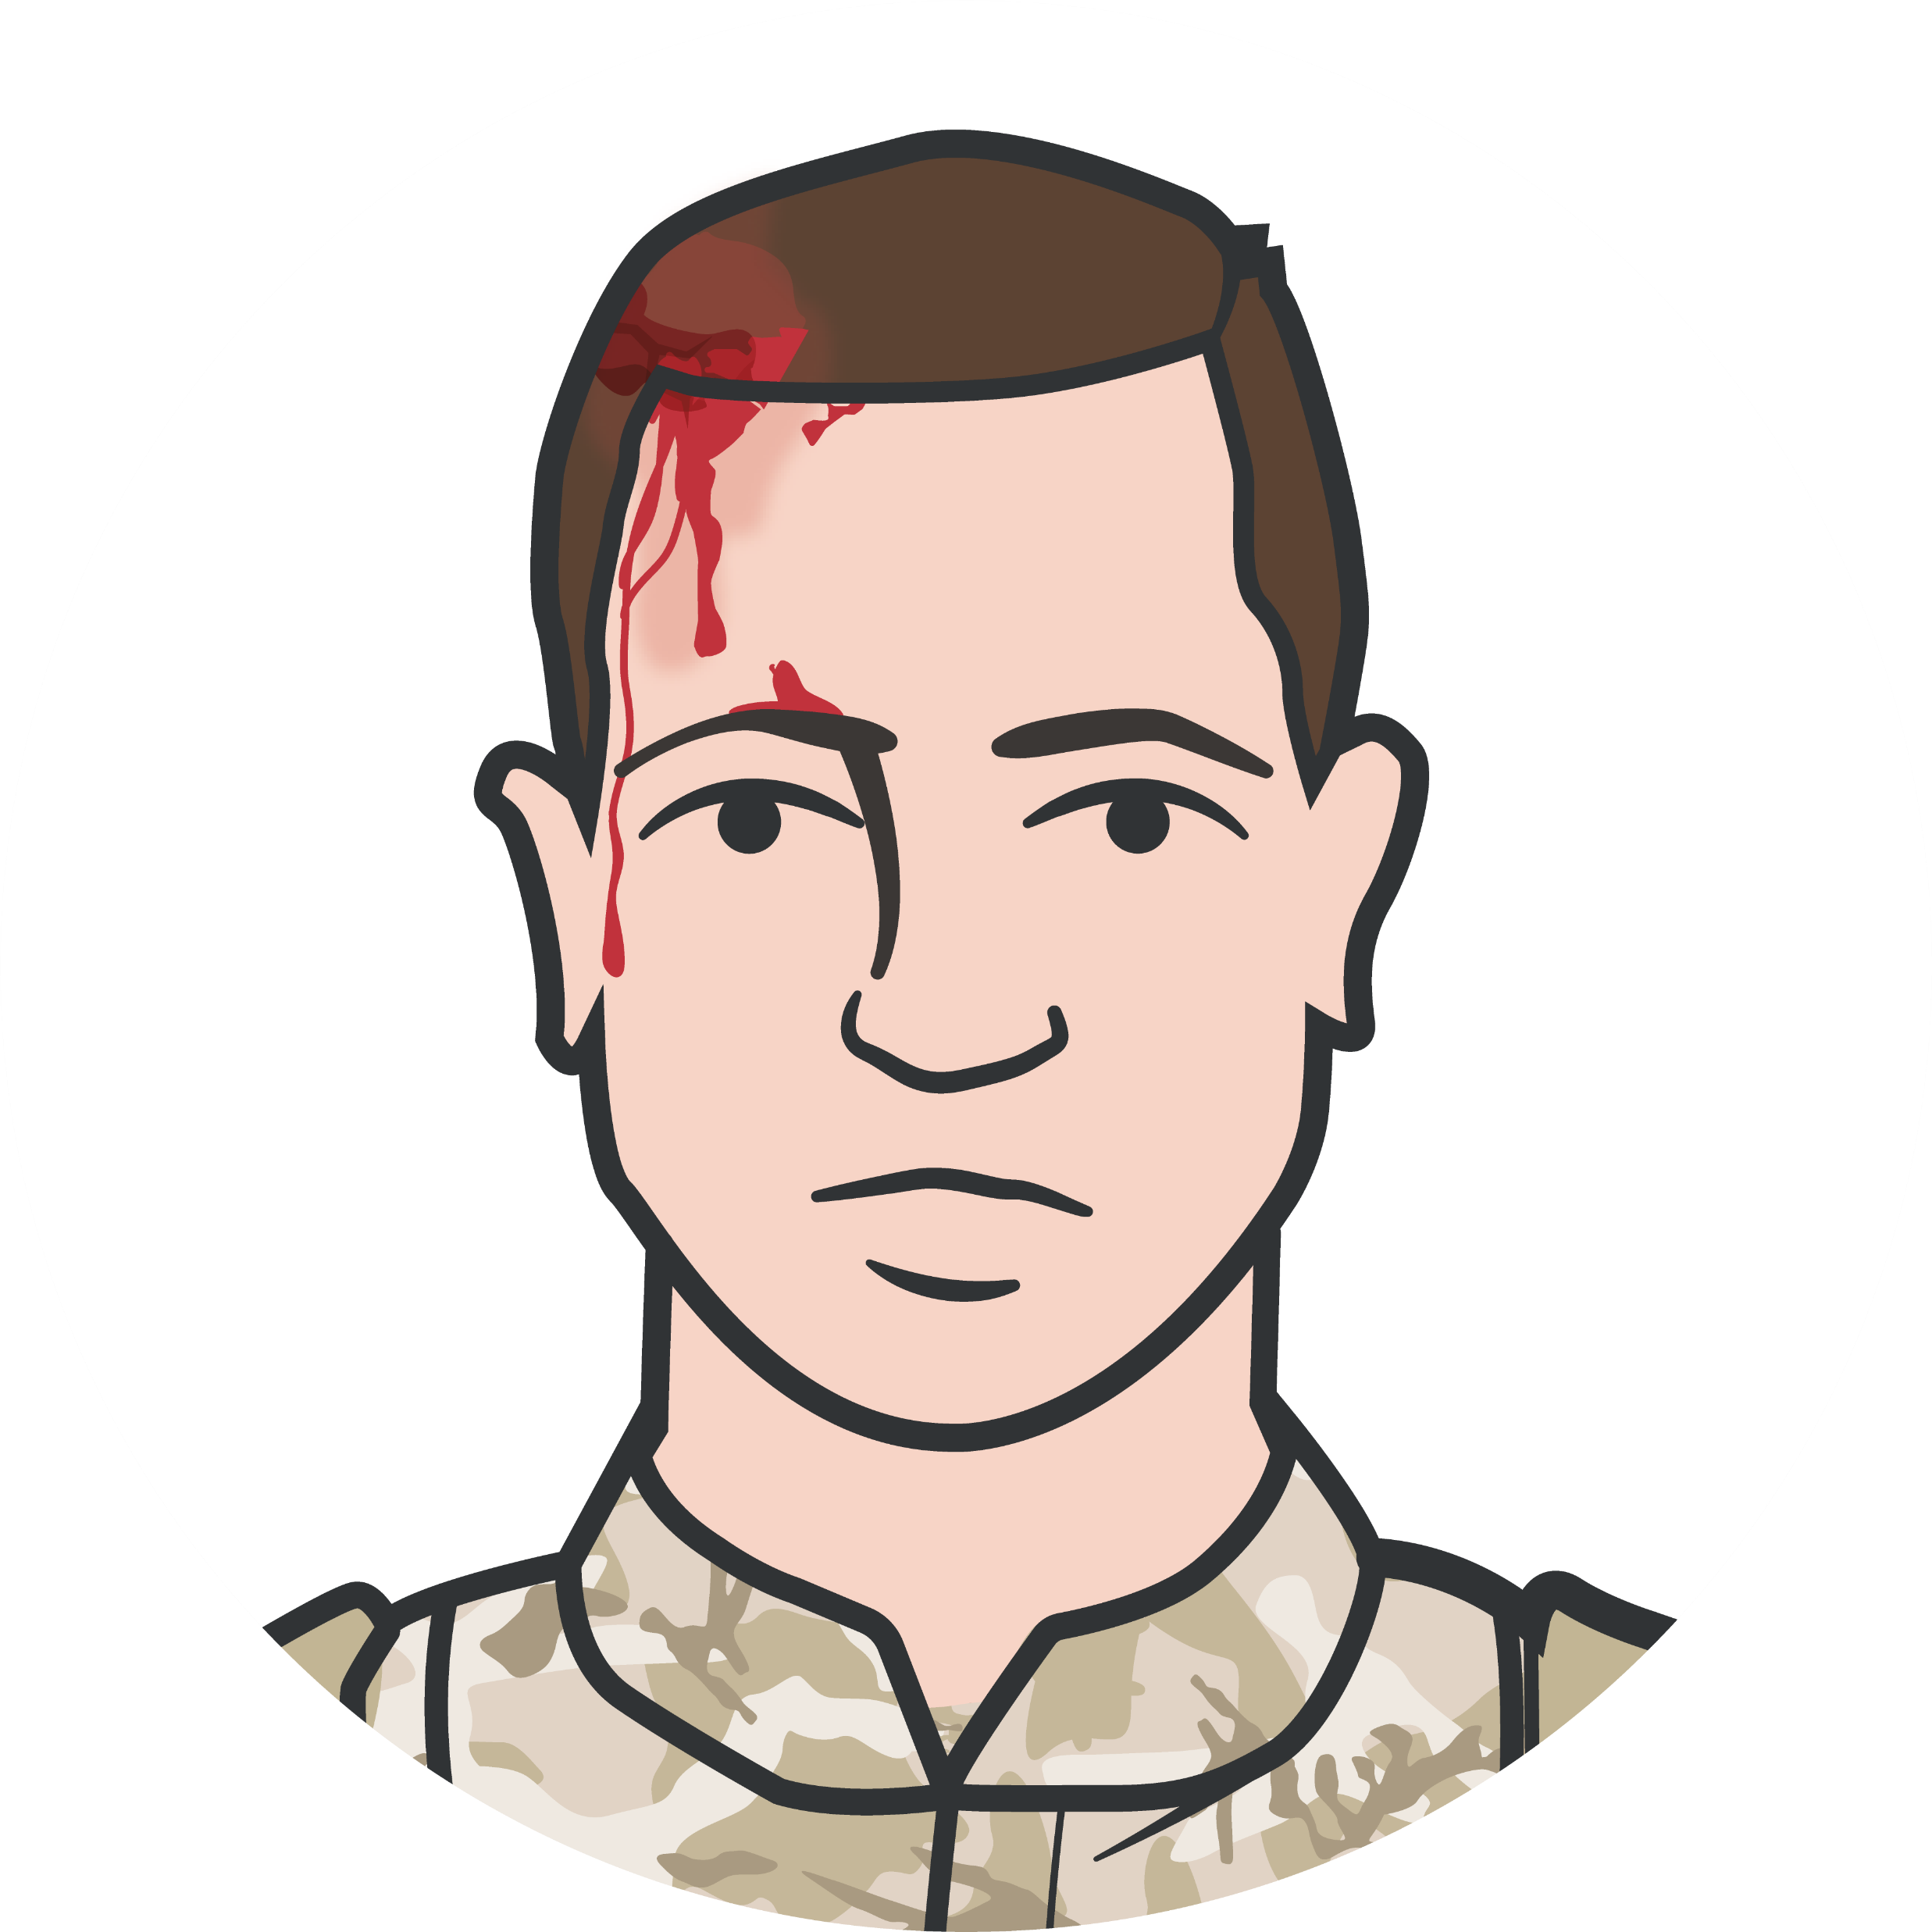
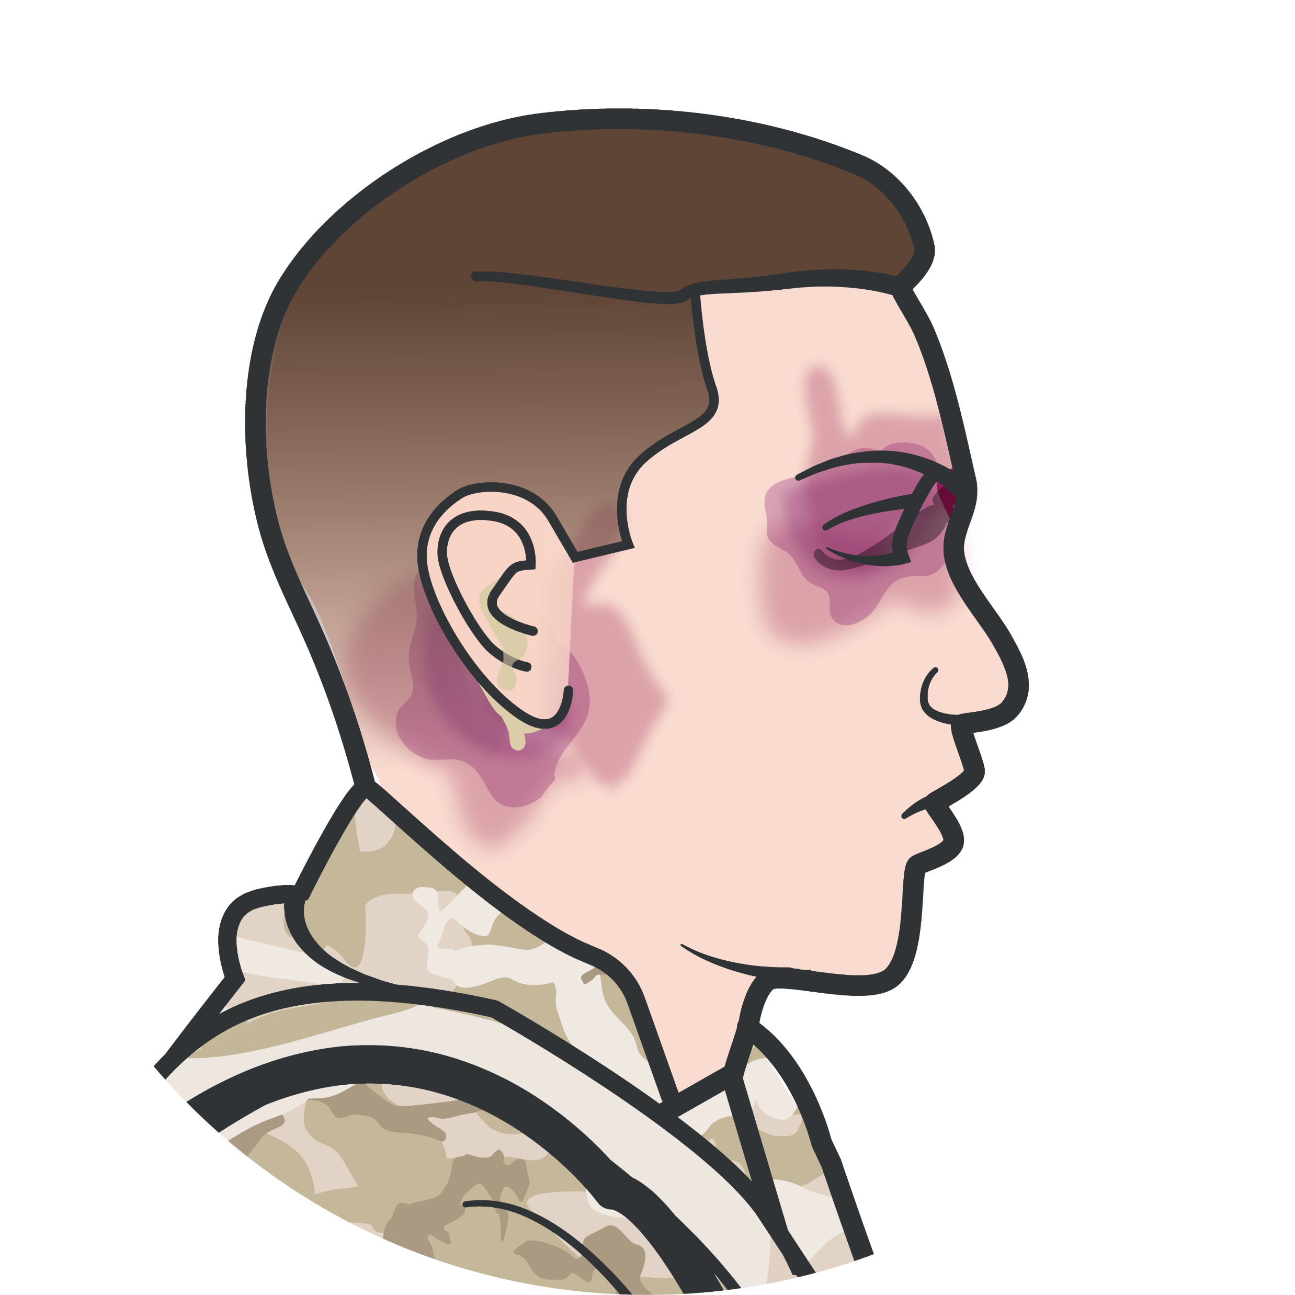
SIGNS AND SYMPTOMS OF HEAD INJURY
Module 13: Head Injuries
Obvious scalp, skull wound or deformity
Altered level of consciousness Pupillary dilation
Otorrhea or rhinorrhea (leakage of cerebrospinal fluid)

Slide 9
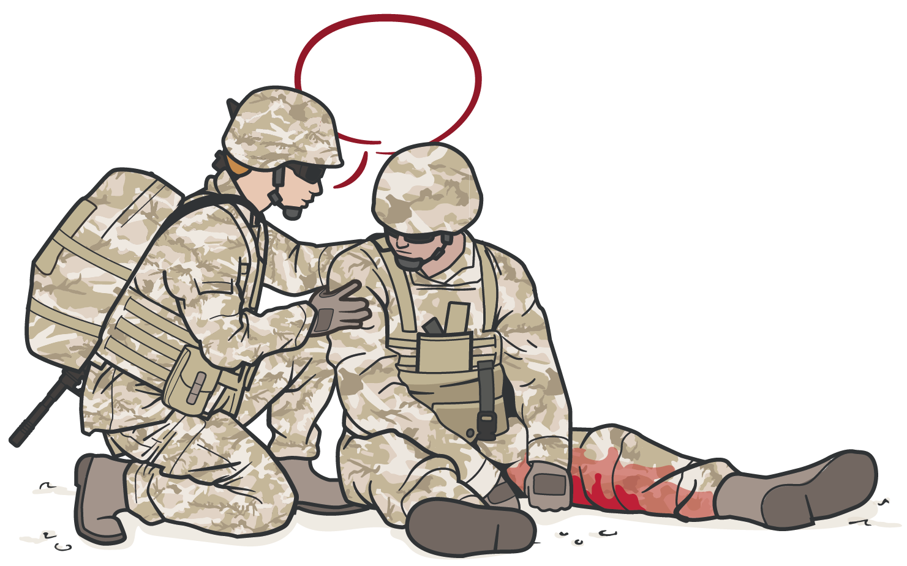
SIGNS AND SYMPTOMS OF HEAD INJURY
Module 13: Head Injuries
COMMUNICATE WITH THE CASUALTY TO ASSESS FOR ALTERED MENTAL STATUS
A
V P U
lert
erbal Stimuli
ainful Stimuli
nresponsive

Slide 10
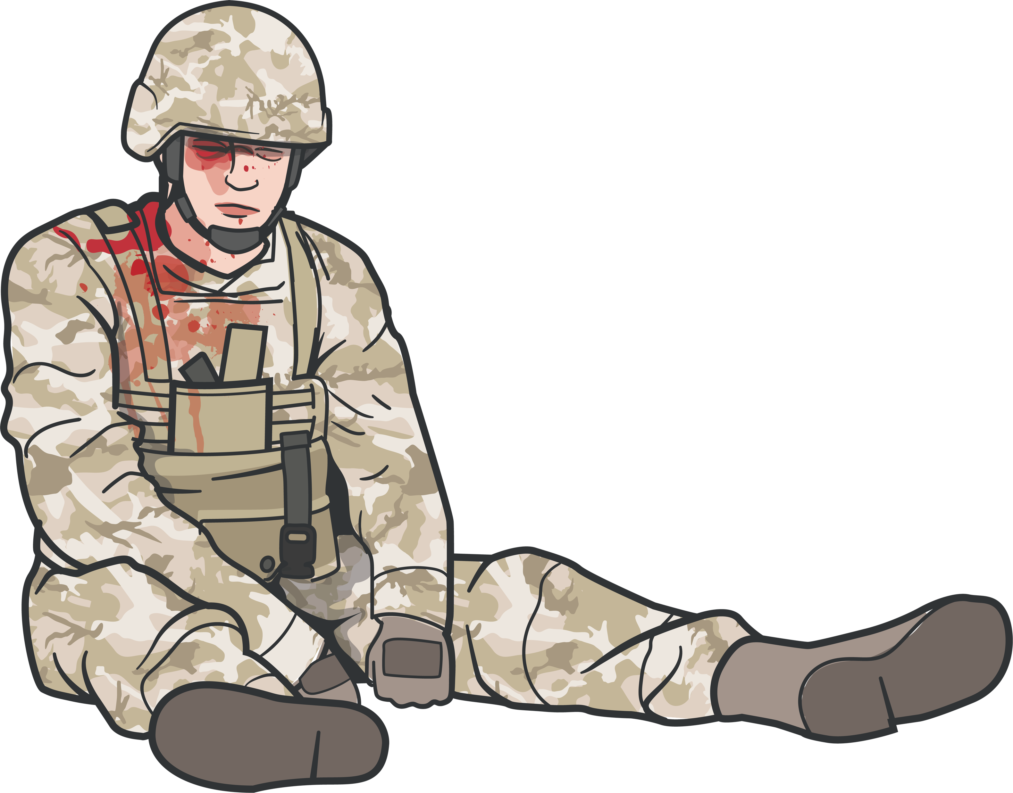
Module 13: Head Injuries
SIGNS AND SYMPTOMS OF HEAD INJURY
I
njury
Physical damage to the body or body part of a Service member?
YES
NO
E valuation
H: Headaches and/or vomiting?
E: Ear ringing?
A: Amnesia, altered consciousness, and/ or loss of consciousness?
D: Double vision and/or dizziness?
S: Something feels wrong or is not right?
YES YES YES YES YES
NO NO NO NO NO
D istance
Was the Service member within 50 meters of the blast? Record the distance from the blast.
YES NO
Not applicable
DoDI 6490.11 (section 3, para 2.a)

Slide 11



SIGNS AND SYMPTOMS OF HEAD INJURY
Module 13: Head Injuries
Mild TBI
(or concussion)
Casualty may remain conscious or lose consciousness only briefly (a few seconds or minutes up to 30 minutes)
Headache, ringing in ears, blurred vision, nausea/vomiting Dizziness/lightheadedness, impaired balance/coordination Confusion/disorientation and/or memory loss (<24 hours)
Moderate TBI
(symptoms similar to mild TBI)
Confusion or disorientation (>24 hours)
Loss of consciousness (> 30 minutes but < 24 hours) Memory loss (>24 hours but < 7 days)
Severe TBI
(symptoms similar to mild TBI)
Confusion or disorientation (>24 hours) Loss of consciousness (> 24 hours) Memory loss (>7 days)

Slide 12
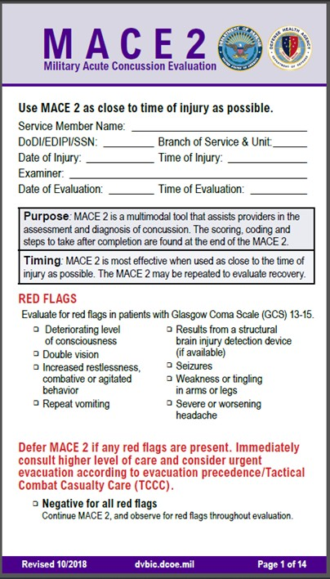
Module 13: Head Injuries
MILITARY ACUTE CONCUSSION EVALUATION 2 INDICATIONS
Trauma casualties with suspected head injury/TBI should be referred to medical personnel as soon as possible for Military Acute Concussion Evaluation 2 (MACE 2)
If ANY of the following RED FLAG signs and symptoms are present, MACE 2 should be deferred and urgent evacuation considered:
Deteriorating level of consciousness Double vision
Increased restlessness; combative or agitated behavior Repeat vomiting
Seizures
Weakness or tingling in arms or legs
Severe or worsening headache
Results from a structural brain injury detection device (if available)

Slide 13
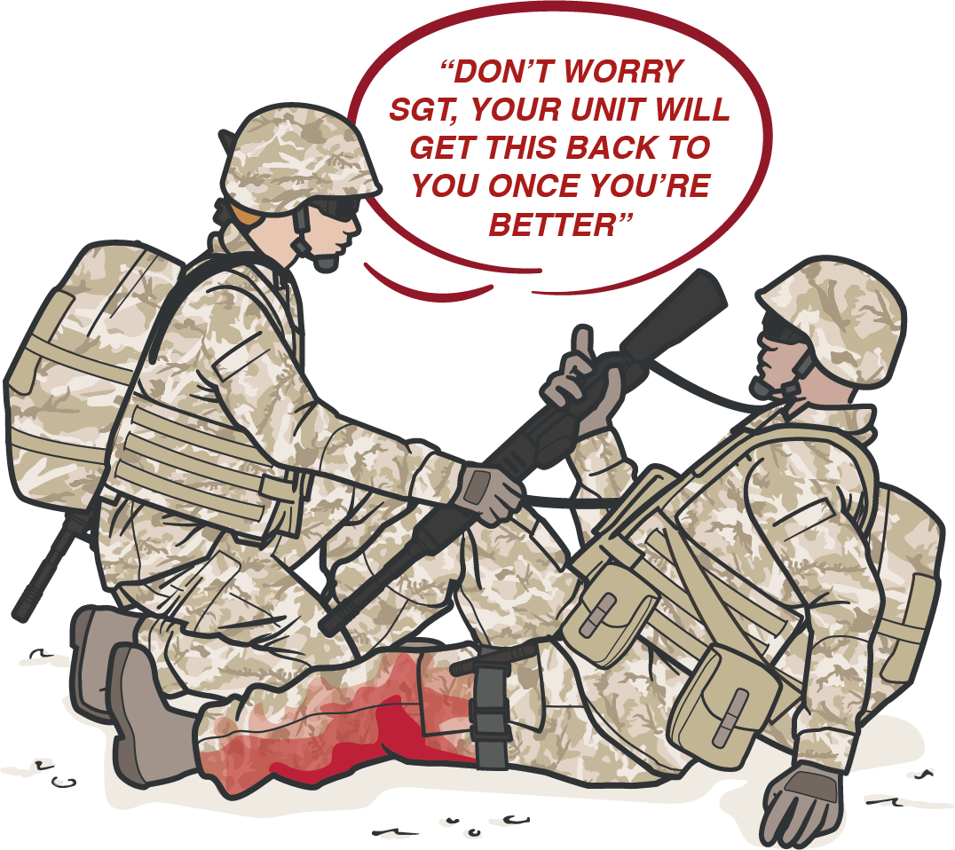
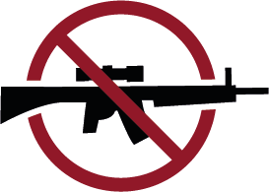

MANAGEMENT OF HEAD INJURIES
Module 13: Head Injuries
DISARM CASUALTY
with altered mental status and have unit point of contact (POC) take control of weapon
If casualty has communication equipment, have the unit POC take control of it, as well

Slide 14

Module 13: Head Injuries
MANAGEMENT OF HEAD INJURIES
Control hemorrhage from head and other injuries; Administer tranexamic acid for significant TBI Secure airway as indicated
Provide supplemental oxygen if available (monitor with pulse oximetry and maintain oxygen saturation >90%)
Resuscitate as indicated (monitor and maintain normal radial pulse or, if blood pressure monitoring is available, systolic blood pressure 100-110 mm Hg)
Treat other immediately life-threatening injuries to prevent hypoxia and hypotension (secondary brain injury)
Prevent/treat hypothermia
Administer antibiotics for all open wounds per TCCC guidelines Manage pain per TCCC guidelines
Prevent secondary brain injury caused by hypoxia and hypotension
Ensure low oxygen saturations are not due to tension pneumothorax and intervene if needed

Slide 15
MONITORING FOR MODERATE TO SEVERE TBI
Module 13: Head Injuries
Decreases in level of consciousness
Pupillary dilation SBP >90 mmHg
O2 sat >90
Hypothermia
Penetrating head trauma C-spine

Slide 16
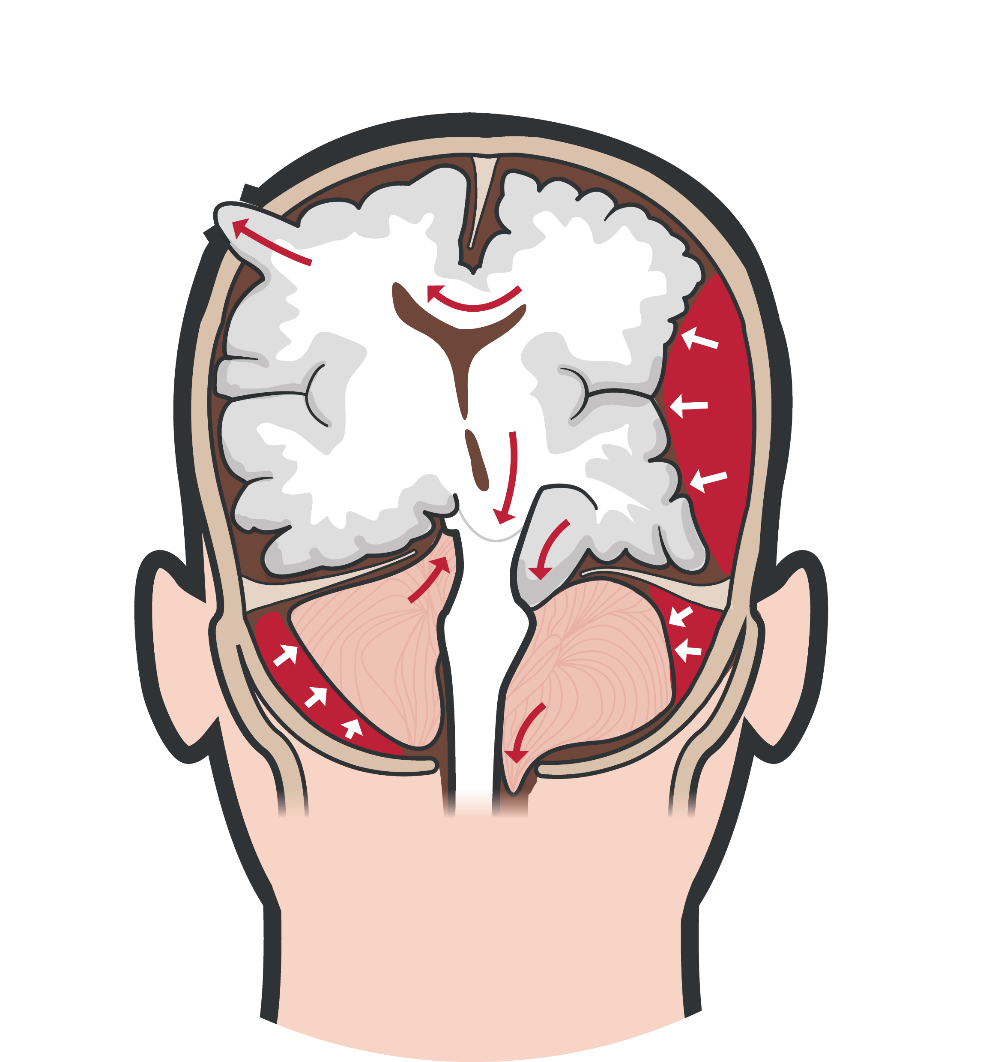
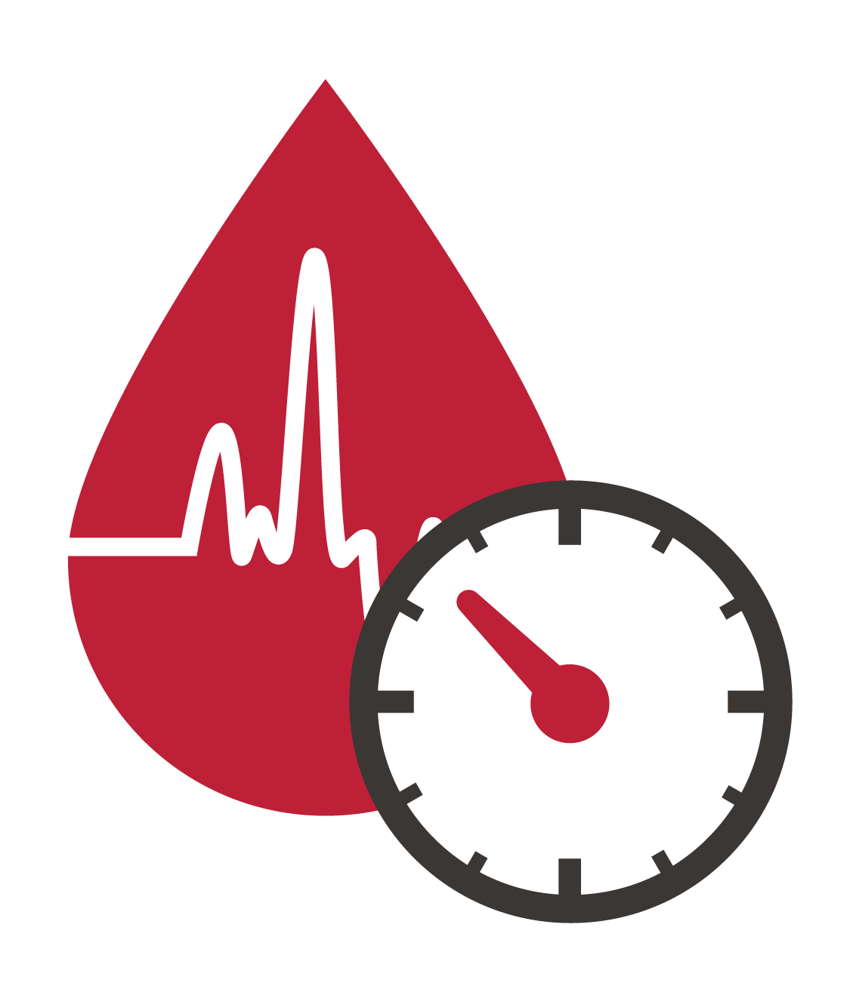


SIGNS AND SYMPTOMS OF CEREBRAL HERNIATION
Module 13: Head Injuries
Deteriorating level of consciousness Dilated (blown) and fixed pupil(s) Erratic breathing patterns
Severe headaches, vomiting, seizures
Abnormal body posturing
Cardiovascular and respiratory irregularities
HIGH BLOOD PRESSURE
LOW HEART RATE
IRREGULAR RESPIRATIONS
IMPORTANT CONSIDERATION:
Casualties with moderate/severe TBI

Slide 17
TREATMENT OF CEREBRAL HERNIATION
Module 13: Head Injuries
Unilateral pupillary dilation accompanied by a decreased level of consciousness may signify impending cerebral herniation, take the following action:
Administer 250 ml of 3 or 5% hypertonic saline IV/IO bolus.
or
30 ml 23% hypertonic saline slow IV/ IO push (over one minute)
Elevate casualty's head 30 degrees
Hyperventilate at 20 breaths per minute
Highest oxygen concentration possible
IMPORTANT CONSIDERATION:
Do not hyperventilate the casualty unless signs of impending herniation are present

Slide 18
SUMMARY
Module 13: Head Injuries
Head injury defined Mechanisms of head injury
Signs and symptoms of head injury
Indications for performing a MACE 2 evaluation for casualties suspected of head injury/TBI
Management of suspected head injury in Tactical Field Care Signs and symptoms of impending cerebral herniation
in Tactical Field Care

Slide 19

CHECK ON LEARNING
What external forces can cause a head injury?
What are the critical observations that should be reported to medical personnel for trauma casualties with a suspected head injury, in accordance with the Military Acute Concussion Evaluation 2 (MACE 2)?
What is the goal of management of casualties with suspected head injury/TBI in TFC?

Slide 20



ANY QUESTIONS?

Slide 21
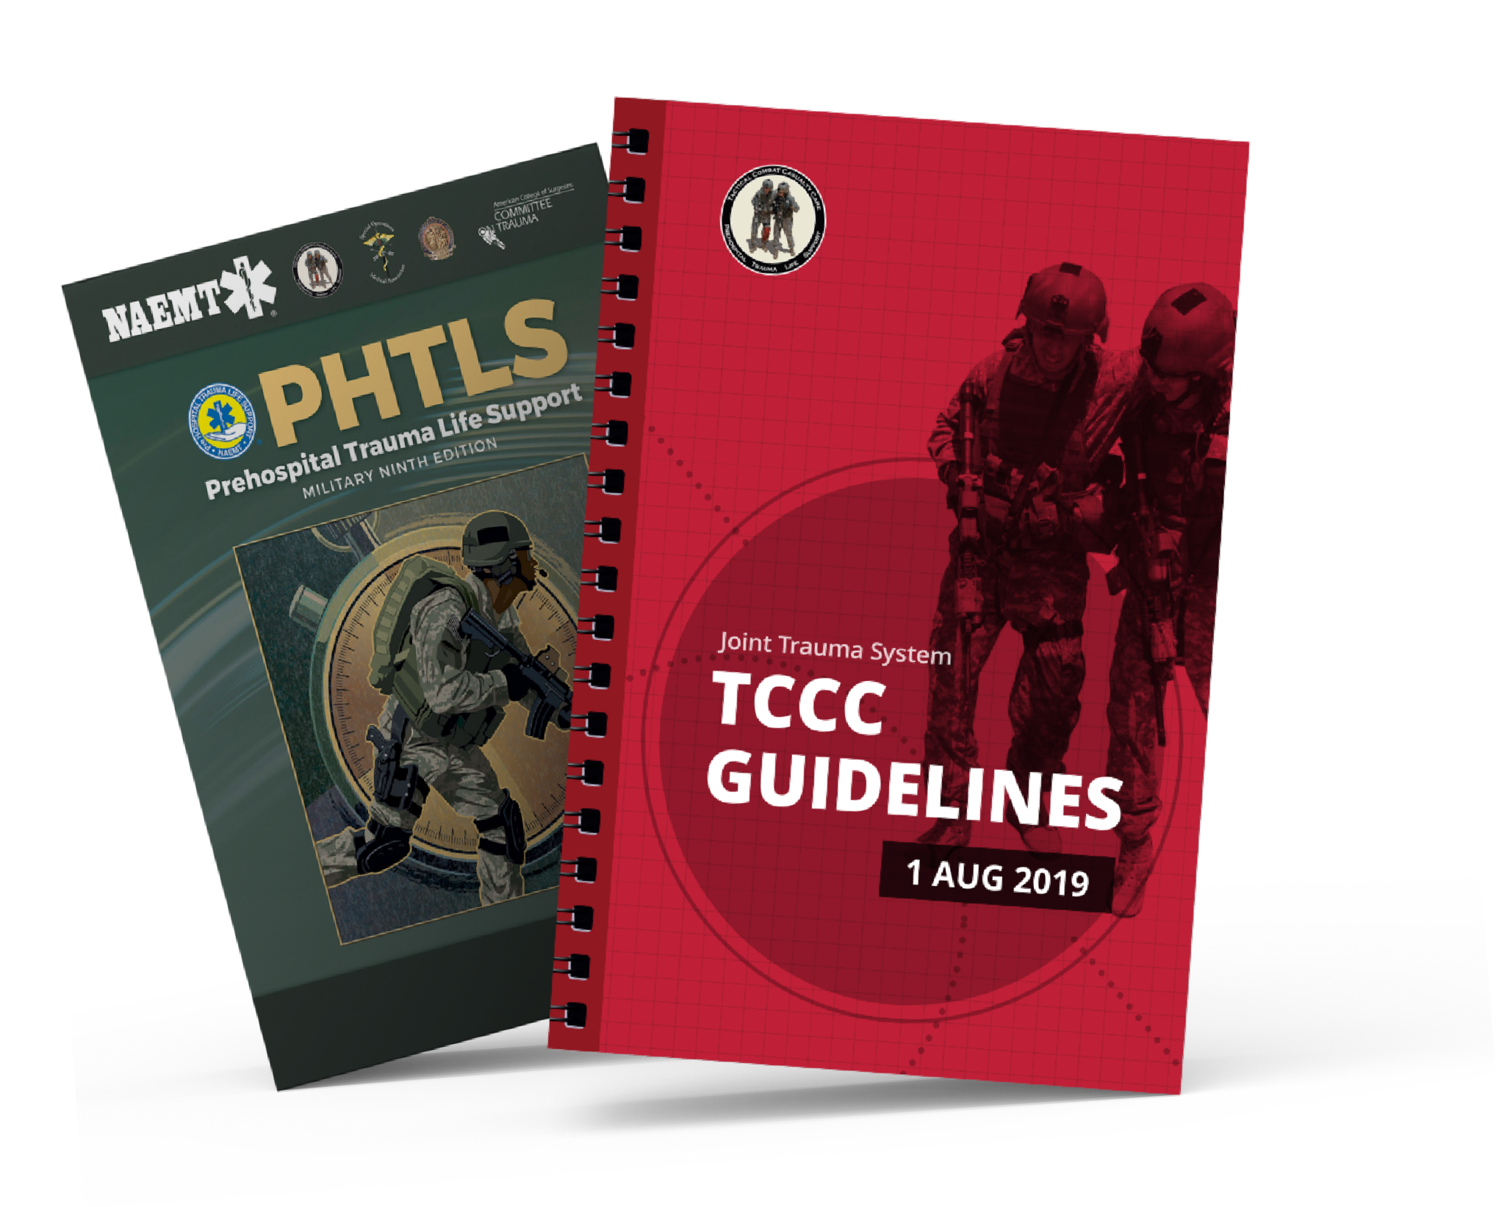
REFERENCES
Module 13: Head Injuries
TCCC: Guidelines
by JTS/CoTCCC
Updated regularly – latest edition dated 5 November 2020
These guidelines are the result of decisions made by the Committee on Tactical Combat Casualty Care as they explore evidence-based research regarding best practices
PHTLS: Military Edition, Chapter 25, 30, & 31
by NAEMT
Prehospital Trauma Life Support, Military Ninth Edition
NOV 2020

